Slide 1

IOT INTEGRATED REAL-TIME TRANSFORMER HEALTH MONITORING AND PROTECTION SYSTEM
Mentor: Mrs. CH Sabitha
PROJECT TEAM MEMBERS:
21ME1A0213 Mr. G Satyanarayana
21ME1A0220 Ms. K Harshitha
21ME1A0217 Ms. K Kavya Sri
21ME1A0224 Mr. K Shyam Prasad

Slide 2

CONTENTS:
Abstract with keywords
Project Objectives
Literature Review
Uniqueness/Novelty of the Idea
Methodology
Block diagram/flow chart
Resources Required
Detailed Execution Plan

Slide 3
INTRODUCTION
The IoT Integrated Real-Time Transformer Health Monitoring and Protection System aims to address the challenge of transformer failures due to factors like overheating, electrical faults, and aging. Traditional methods rely on manual inspections and scheduled maintenance, which may fail to detect emerging issues in time. The IoT-based system uses sensors to continuously monitor parameters such as temperature, vibration, and electrical conditions. This data is analyzed in real time to predict potential faults, enabling early alerts and proactive maintenance. The system also features automated protection measures, improving transformer safety, reliability, and efficiency while preventing costly downtime and failures.

Slide 4
PROBLEM STATEMENT & OBJECTIVES
Aim:-
The primary aim of the IoT Integrated Real-Time Transformer Health Monitoring and Protection System is to revolutionize the way power transformers are monitored and maintained. Traditional methods of transformer monitoring are often manual, periodic, and reactive, leading to delayed fault detection, increased downtime, and higher maintenance costs
Objective:-
The objectives of the IoT Integrated Real-Time Transformer Health Monitoring and Protection System focus on developing a system to continuously monitor key transformer parameters using IoT technology for real-time visualization, remote monitoring, and data storage.

Slide 5
LITERATURE SURVEY
Overview of past research:
Research on IoT-based transformer health monitoring has progressed from basic sensor systems to advanced real-time solutions using cloud platforms and predictive technologies. While effective in improving safety and reliability, challenges like data security and performance in remote areas still need to be addressed
Relevant references:
Various studies have advanced IoT-based transformer health monitoring by integrating sensors, wireless communication, and cloud platforms. Researchers have developed systems for real-time data tracking, remote alerts, and predictive maintenance using AI.

Slide 6
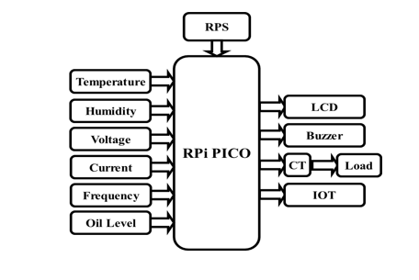
EXISTING / TRADITIONAL SYSTEM
Block Diagram:
Figure 1: Block Diagram

Slide 7
EXISTING / TRADITIONAL SYSTEM
Drawbacks/Limitations:
Unreliable internet connectivity in remote areas.
Data security risks without proper encryption.
Sensor inaccuracy due to environmental factors.
Power supply dependency for continuous operation.
High initial cost for setup and components.
Regular maintenance and sensor calibration needed.
Data overload requiring proper management tools.
Limited fault prediction without AI integration.
Environmental interference affecting performance.

Slide 8
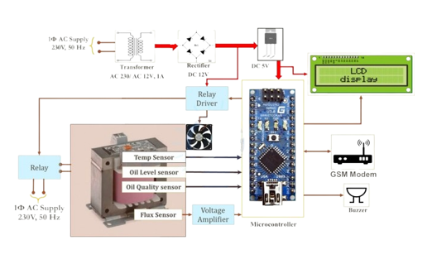
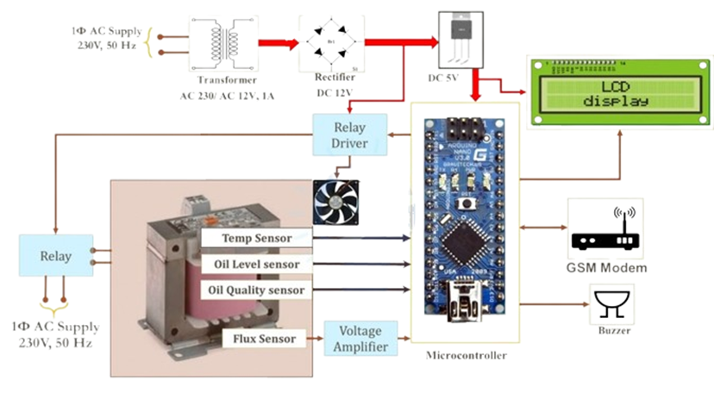
METHODOLOGY / PROPOSED SYSTEM
Figure 2: Methodology

Slide 9
METHODOLOGY / PROPOSED SYSTEM
Working principle:
The IoT-based transformer monitoring system uses sensors to track parameters like temperature, voltage, and oil level in real time. A microcontroller processes this data and sends it to the cloud via Wi-Fi for remote monitoring.
The collected data is sent to a microcontroller (like ESP32 or Arduino), which processes and compares the readings with predefined safety limits. If abnormal conditions are detected, the system sends alerts and can automatically disconnect the transformer to prevent damage. It also logs data for analysis, enabling predictive maintenance and improving overall safety and efficiency.

Slide 10
HARDWARE & SOFTWARE REQUIREMENTS
List of components:
S. No | Name of the Component | Rating | Purpose
1 | Regulated Power Supply | 5V/12V | To supply a stable power source to the system components.
2 | Raspberry Pi Pico Microcontroller | 5V | To control and process data from various sensors.
3 | Current Transformer (CT) | 5A-1000A | To measure the load current in the transformer.
4 | LCD Display | 16x2 | To display real-time data from the transformer monitoring system.
5 | Temperature Sensor | 0-100°C | To monitor the temperature of the transformer.
6 | Voltage Sensor | 0-500V | To monitor the voltage levels of the transformer.
7 | Cloud Platform (e.g., ThingSpeak) | N/A | For real-time data storage and visualization.
8 | Oil Quality Sensor | N/A | To monitor the quality of the transformer oil.
9 | IoT Module | 3.3V | To enable wireless communication and data transmission.
10 | Arduino IDE Software | N/A | for coding and uploading to microcontrollers
11 | Thing Speak / Firebase / Blynk | N/A | for real-time data monitoring and storage

Slide 11
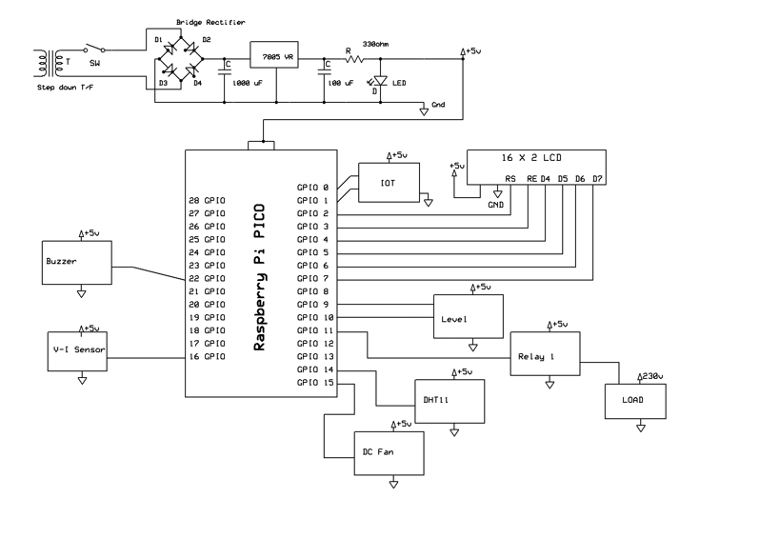
DESIGN & IMPLEMENTATION
Circuit diagram:
Figure 3: Circuit Diagram

Slide 12
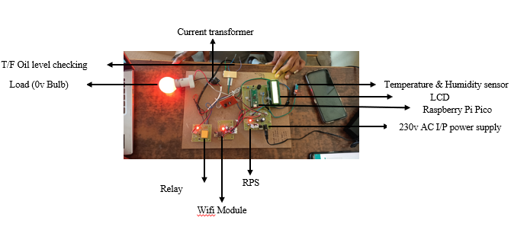
DESIGN & IMPLEMENTATION
Prototype development:
Figure 4: Prototype Of Project

Slide 13
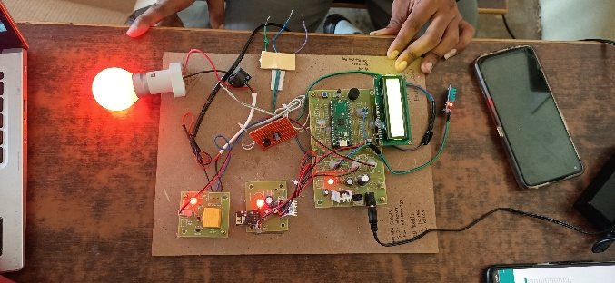
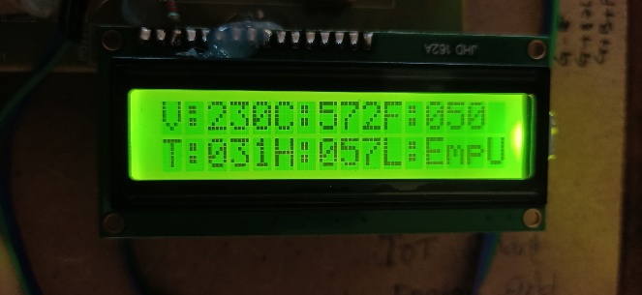
RESULTS & OBSERVATIONS
IoT Kit in Working Condition with All Parameters Monitored
LCD Output Displaying Transformer Health in Good Condition
Figure 5: Working Condition
Figure 6: LCD Output

Slide 14
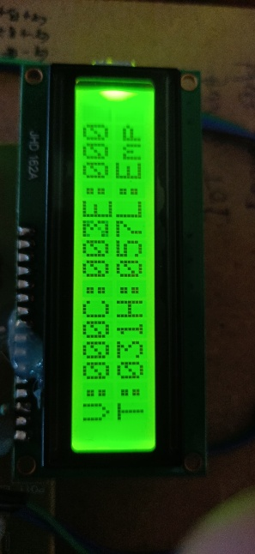
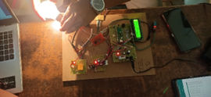
RESULTS & OBSERVATIONS
Sudden Load Change Response with Overvoltage Protection
Load Disconnected Display After Overload
Figure 7: Sudden Load Changes
Figure 8: Load Disconnected Display After Over Load

Slide 15

RESULTS & OBSERVATIONS
Substation Computer Display Data
S.No | Temperature | Humidity | Voltage | Current | Frequency | Oil_Level | Date
1 | 31 | 57 | 230 | 238 | 50 | Full | 2025-03-29 10:19:47
2 | 31 | 58 | 230 | 237 | 50 | Full | 2025-03-29 10:18:45
3 | 31 | 57 | 230 | 238 | 50 | Full | 2025-03-29 10:17:36
4 | 31 | 56 | 230 | 238 | 50 | Full | 2025-03-28 12:11:47
5 | 31 | 57 | 230 | 237 | 50 | Full | 2025-03-28 11:10:47
6 | 31 | 58 | 0 | 0 | 0 | Empty | 2025-03-28 10:09:45
7 | 32 | 56 | 230 | 238 | 50 | Full | 2025-03-27 09:19:47
8 | 31 | 57 | 230 | 237 | 50 | Full | 2025-03-27 09:16:56
9 | 31 | 57 | 230 | 238 | 50 | -1 | 2025-03-27 09:10:26
10 | 31 | 57 | 230 | 237 | 50 | Full | 2025-03-26 02:43:56
11 | 31 | 57 | 230 | 237 | 50 | -1 | 2025-03-26 11:24:32
12 | 31 | 57 | 230 | 238 | 50 | Full | 2025-03-26 10:56:51
13 | 31 | 57 | 230 | 238 | 50 | Full | 2025-03-25 01:45:47
14 | 32 | 57 | 0 | 0 | 0 | Empty | 2025-03-25 12:17:54
15 | 31 | 58 | 230 | 237 | 50 | Full | 2025-03-25 11:19:25

Slide 16
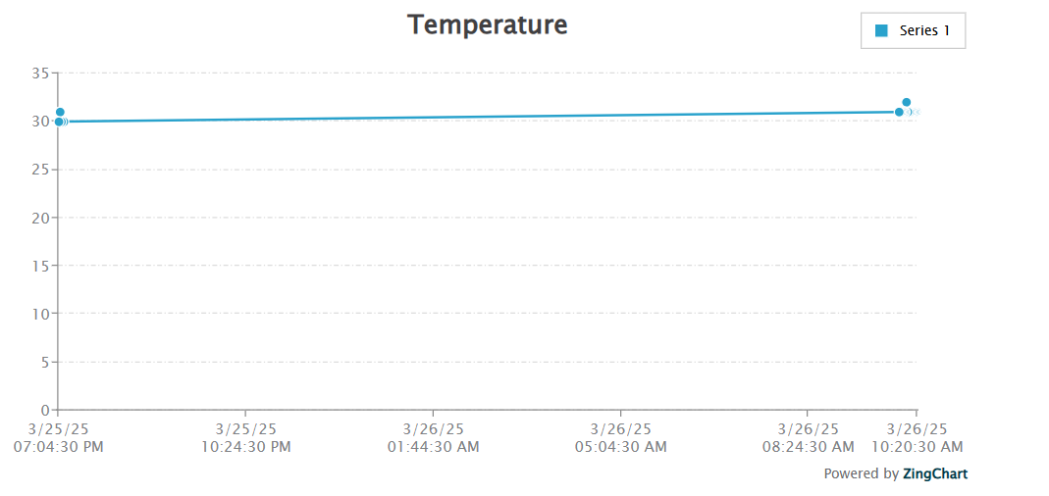
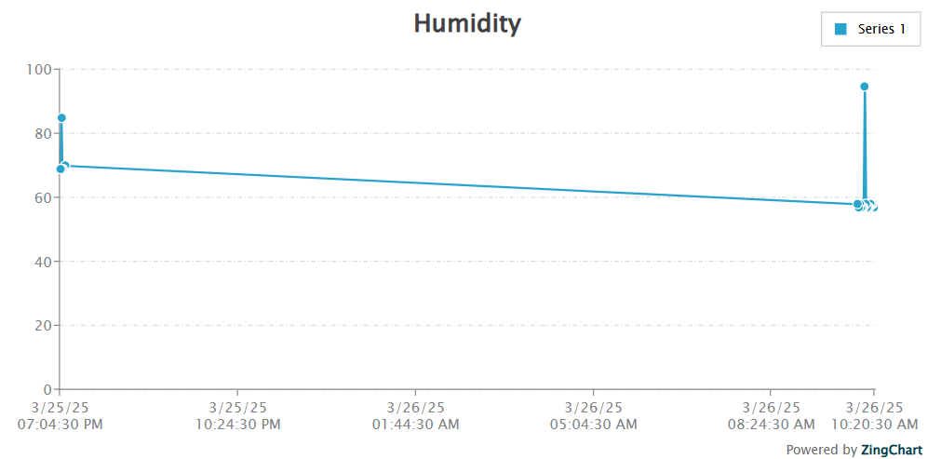
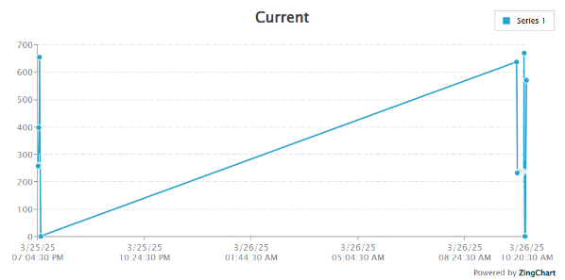
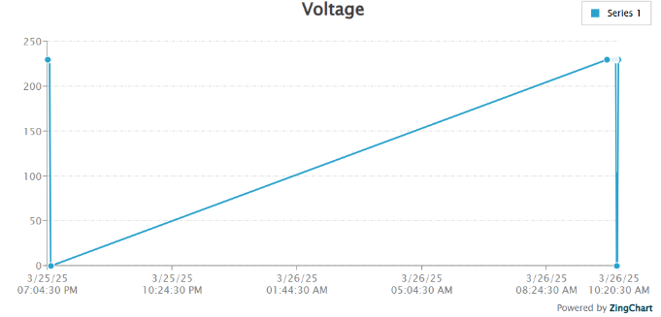
RESULTS & OBSERVATIONS Graph

Slide 17
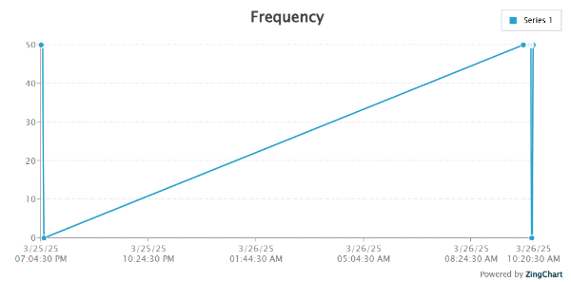
RESULTS & OBSERVATIONS Graph

Slide 18
RESULTS & OBSERVATIONS
Key Observations:
Enables real-time monitoring of transformer parameters
Detects faults early to prevent major damage
Allows remote access via cloud or mobile apps
Sends automated alerts and performs protective actions
Supports data logging for analysis and maintenance planning
Reduces manual inspection and maintenance costs
Improves safety and reliability of the power system
Scalable for larger transformer networks and smart grids

Slide 19
ADVANTAGES & APPLICATIONS
Benefits of the project:
The project provides real-time monitoring, early fault detection, and remote access, helping prevent transformer failures. It reduces maintenance costs, extends equipment lifespan, and improves energy efficiency through data logging and predictive maintenance.
Real World Applications:
Power distribution companies – for reliable grid operation.
Industrial plants – to avoid production downtime.
Smart grids – for intelligent energy management.
Renewable energy systems – in solar and wind power stations.
Remote/rural electrification – where manual checks are difficult.
Utilities and substations – for centralized transformer monitoring.

Slide 20
CONCLUSION
Summary of key findings:
Enables real-time monitoring of transformer health
Detects faults early to prevent major damage
Allows remote data access via IoT platforms
Reduces manual effort and maintenance costs
Improves overall safety and reliability
Final thoughts:
The project offers a smart, reliable, and efficient solution for transformer monitoring using IoT. It enhances safety, supports predictive maintenance, reduces costs, and is scalable for modern power systems. Overall, it's a valuable step toward smarter and more sustainable energy management.

Slide 21
REFERENCES
List of references in IEEE format:
[1]Kumar, A., Singh, P., & Sharma, R. (2020). "IoT-Based Transformer Monitoring System for Smart Grids." IEEE Transactions on Industrial Informatics, 16(5), 3456-3465.
[2]Sharma, S., & Patel, R. (2019). "Real-Time Monitoring of Power Transformers Using IoT." International Journal of Electrical and Electronics Engineering, 12(3), 123 130
.[3]Zhang, Y., Li, X., & Wang, H. (2018). "Wireless Sensor Networks for Transformer Health Monitoring." IEEE Sensors Journal, 18(10), 4123-4132.
[4]Singh, R., Gupta, S., & Kumar, V. (2021). "Cloud-Based Transformer Monitoring Using IoT and Machine Learning." IEEE Access, 9, 56789-56800.

Slide 22
REFERENCES
[5]Wang, J., Chen, L., & Liu, Y. (2017). "Fiber Optic Sensors for Transformer Monitoring." IEEE Transactions on Power Delivery, 32(4), 2100-2108
[6]Patel, N., & Desai, K. (2020). "GSM-Based Transformer Monitoring System." International Journal of Advanced Research in Electrical and Electronics Engineering, 7(2), 45-52.
[7]Li, H., Zhang, W., & Zhao, Q. (2019). "Smart Grid-Integrated Transformer Monitoring Using IoT and Edge Computing." IEEE Internet of Things Journal, 6(4), 6789-6798.
[8]Gupta, A., Mishra, S., & Rao, P. (2022). "AI Algorithms for Predictive Maintenance of Transformers." IEEE Transactions on Smart Grid, 13(1), 456-465.

Slide 23


